Slide 1
VARIATIONAL CLASSIFIER AND QUANVOLUTIONAL NEURAL NETWORK
WOMANIUM QUANTUM+AI PROJECT
QUANTUM ENTANGLERS
Sunita(khothsunita1508@gmail.com)
Enrollment ID : WQ24-kntLxdjlEEqKqC9
Rajana Rama Satya Sai Durga Prasad(rajanasatyasai@gmail.com)
Enrollment ID : WQ24-UkA0PEQyOfbIQTn

Slide 2
CONTENTS
WOMANIUM QUANTUM+AI PROJECT
Problem statement
Variational Quantum Classifier(VQC)
Classical Convolutional Neural Network(CCNN)
Quantum Convolutional Neural Network(QCNN)
Results

Slide 3
Variational Quantum Classifier(VQC)
WOMANIUM QUANTUM+AI PROJECT
Variational Quantum Classifier (VQC) is a quantum-inspired classification algorithm designed to categorize input data into predefined classes or categories. Unlike classical classifiers that rely solely on classical computation, VQC harnesses the computational power of quantum systems to perform classification tasks more efficiently and potentially with higher accuracy.
The Key components of VQC Include:-
• Quantum Feature Maps
• Parameterized Quantum Circuits (Ansatz)
• Variational Optimization Algorithms

Slide 4
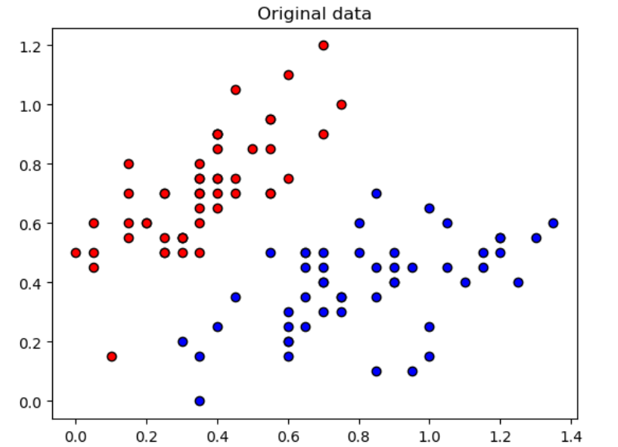
Plotting Original Data
WOMANIUM QUANTUM+AI PROJECT

Slide 5
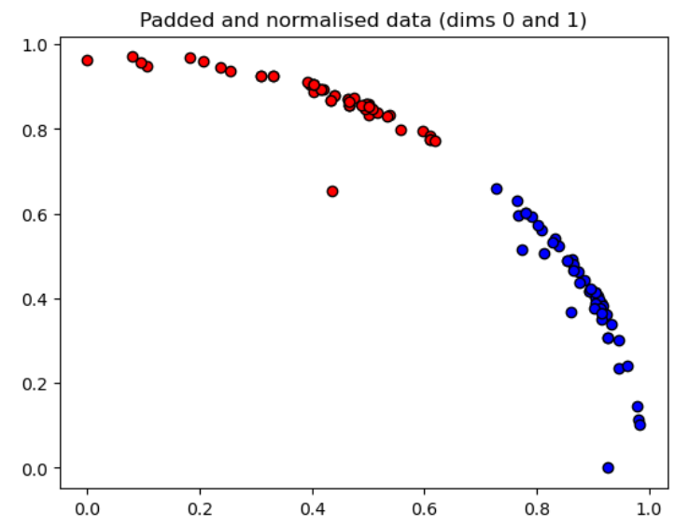
Plotting Padded and Normalized Data
WOMANIUM QUANTUM+AI PROJECT

Slide 6
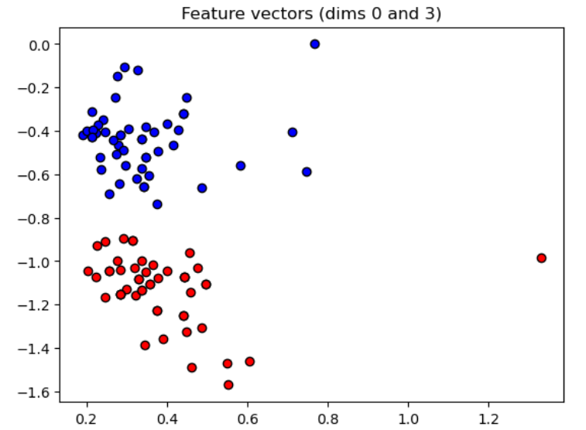
Plotting Feature Vectors
WOMANIUM QUANTUM+AI PROJECT

Slide 7
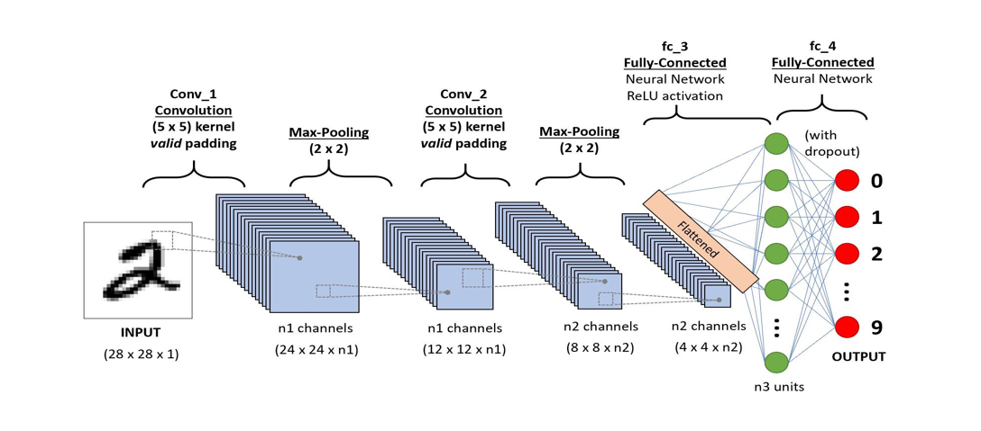
Classical Convolutional Neural Network(CCNN)
WOMANIUM QUANTUM+AI PROJECT
src: https://dotnettutorials.net/lesson/convnet-architecture-in-cnn/

Slide 8
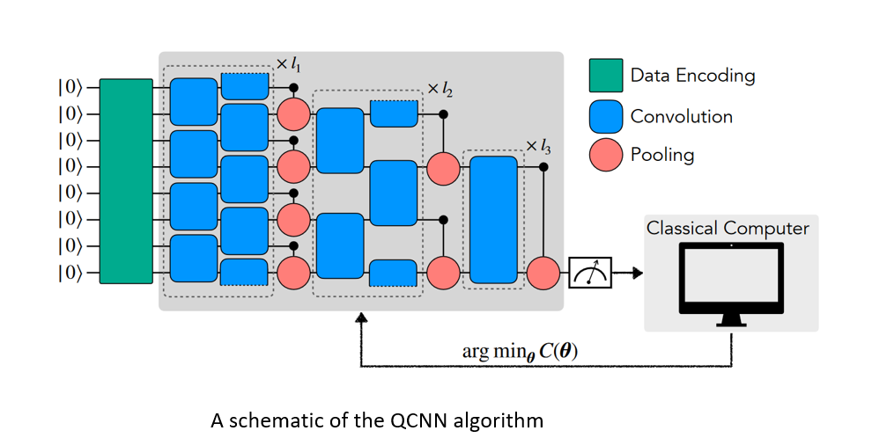
Quantum Convolutional Neural Network(QCNN)
WOMANIUM QUANTUM+AI PROJECT
src: http://dx.doi.org/10.1007/s42484-021-00061-x

Slide 9
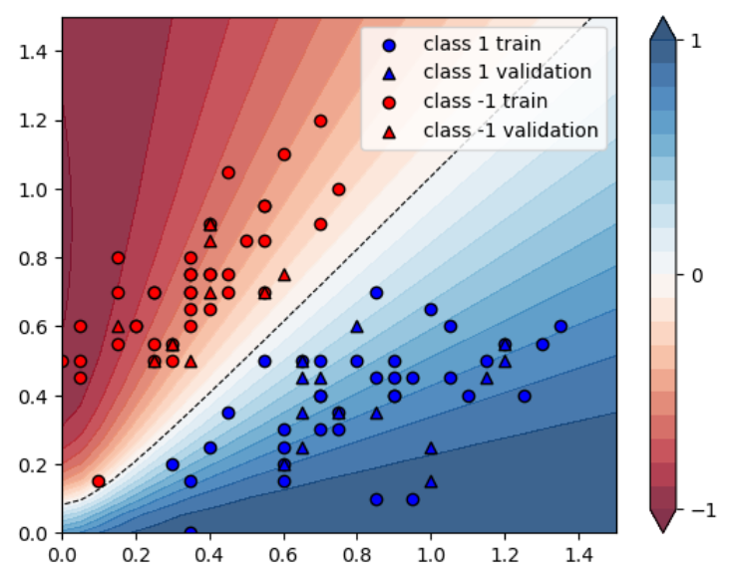
RESULTS
WOMANIUM QUANTUM+AI PROJECT
1. VQC
The training and validation data points

Slide 10
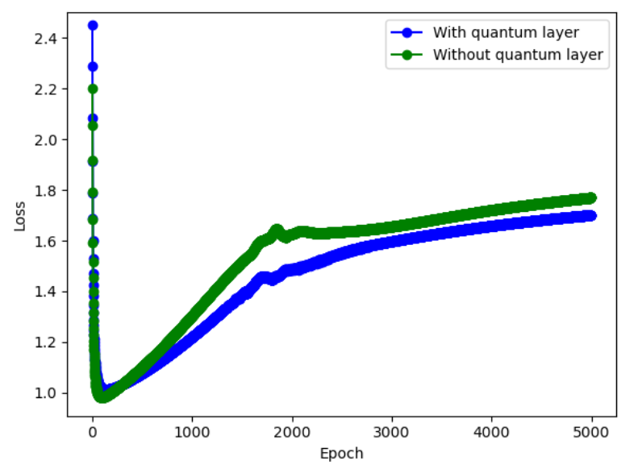
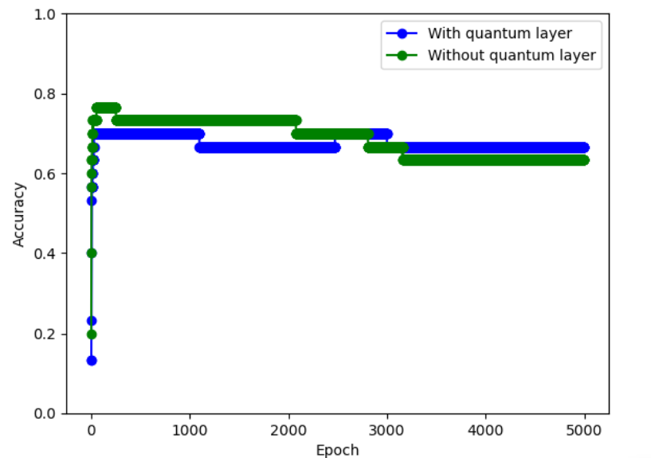
2.QCNN Classical Results on MNIST dataset without quantum pre-processing
WOMANIUM QUANTUM+AI PROJECT

Slide 11
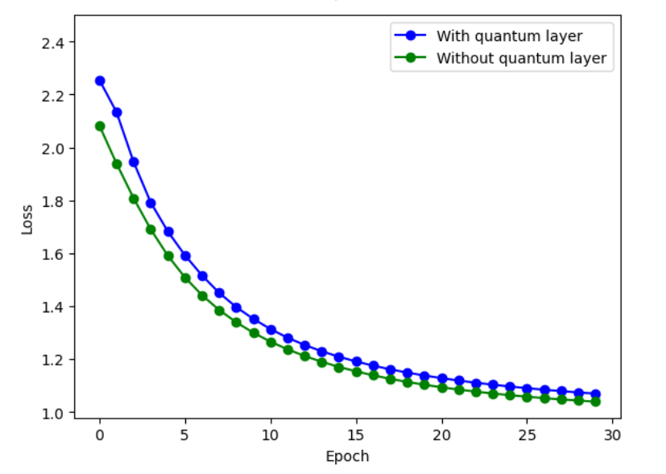
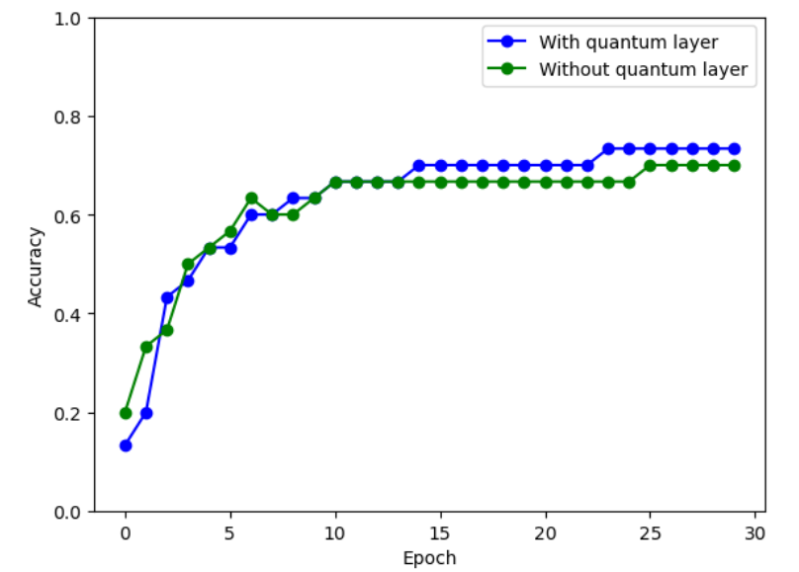
Results on MNIST dataset using quantum pre-processing
WOMANIUM QUANTUM+AI PROJECT

